Slide 1
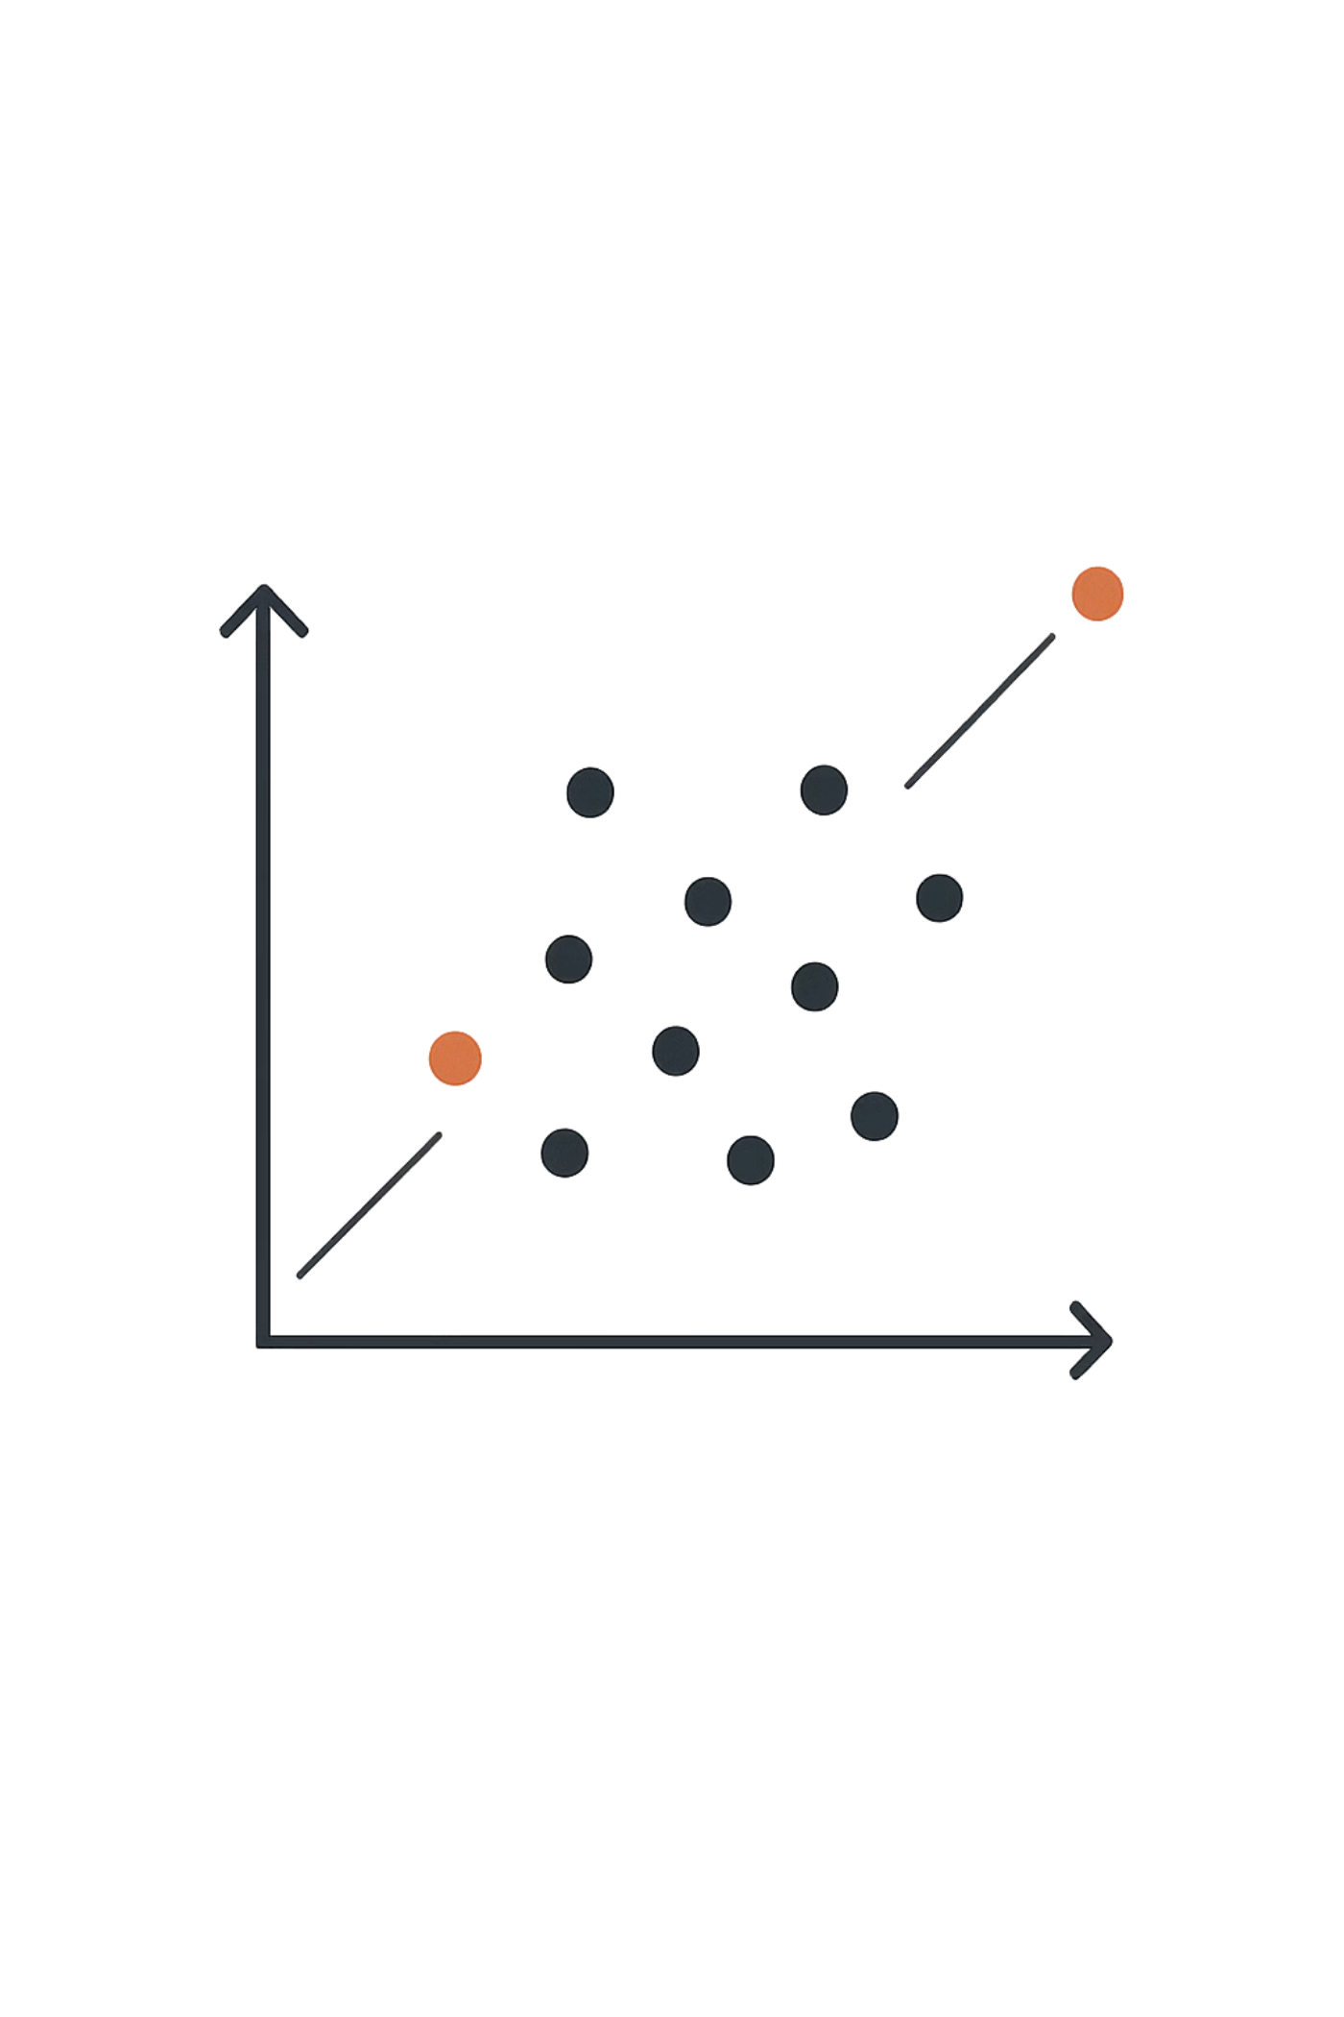
Outlier Analysis
Introduction, Challenges & Detection Methods
JIYA CHAUDHARY
RA2311003030560
BTECH CSE CORE I

Slide 2

What Are Outliers?
Outliers are data points that significantly differ from the majority of observations in a dataset. They are not merely noise — they often carry critical information.
⚠️ Data Errors
🔍 Rare Events
💡 Key Insights
Mistakes in collection or entry
Fraud, intrusions, medical anomalies
Signals worth investigating further

Slide 3
Challenges in Detecting Outliers
Outlier detection is far from straightforward. Real-world data introduces several complications that make identifying true anomalies a nuanced task.
Defining "Normal"
High Dimensionality
Noise vs. Outliers
Boundary between normal and abnormal is often ambiguous and context-dependent
Curse of dimensionality obscures distance-based signals in complex datasets
Distinguishing random noise from genuine anomalies is inherently difficult
Lack of Labels
Evolving Patterns
Annotated outlier datasets are rare and expensive to produce
Data distributions shift over time, making static models unreliable

Slide 4

Outlier Detection: Three Approaches
The choice of detection method depends primarily on how much labeled data is available. Each approach has distinct strengths and use cases.
Semi‑Supervised
Supervised
Unsupervised
Supervised methods offer the highest accuracy when labels exist. Semi-supervised methods bridge the gap when only normal examples are available. Unsupervised methods are the most flexible, requiring no prior labels at all.

Slide 5
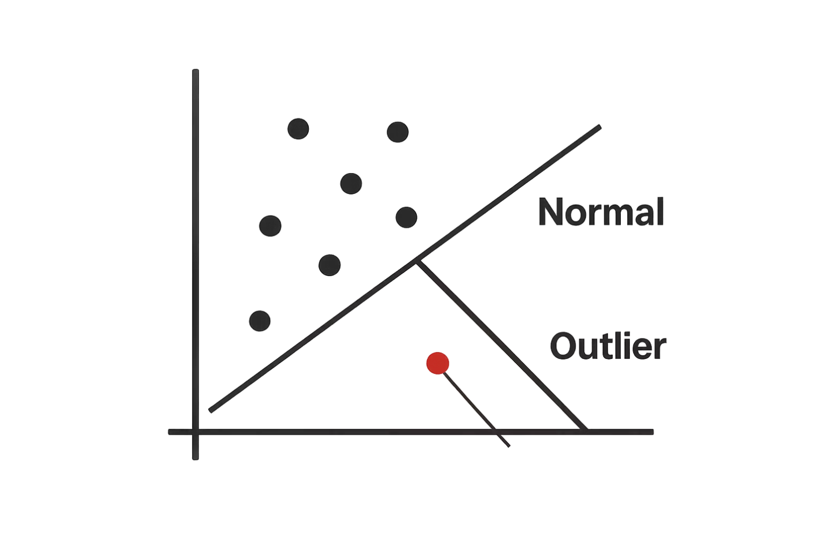
Supervised & Semi-Supervised Methods
Supervised Methods
Trained on labeled data containing both normal points and known outliers. Classification models learn the boundary directly.
1
High accuracy when labels are reliable
Requires a representative labeled dataset
Examples: SVM, Decision Trees, Neural Networks
Semi-Supervised Methods
Trained only on normal data. Anything deviating significantly from the learned normal profile is flagged as an outlier.
2
Ideal when outliers are rare or unknown
Models the "normal" class in depth
Examples: One-Class SVM, Autoencoders

Slide 6
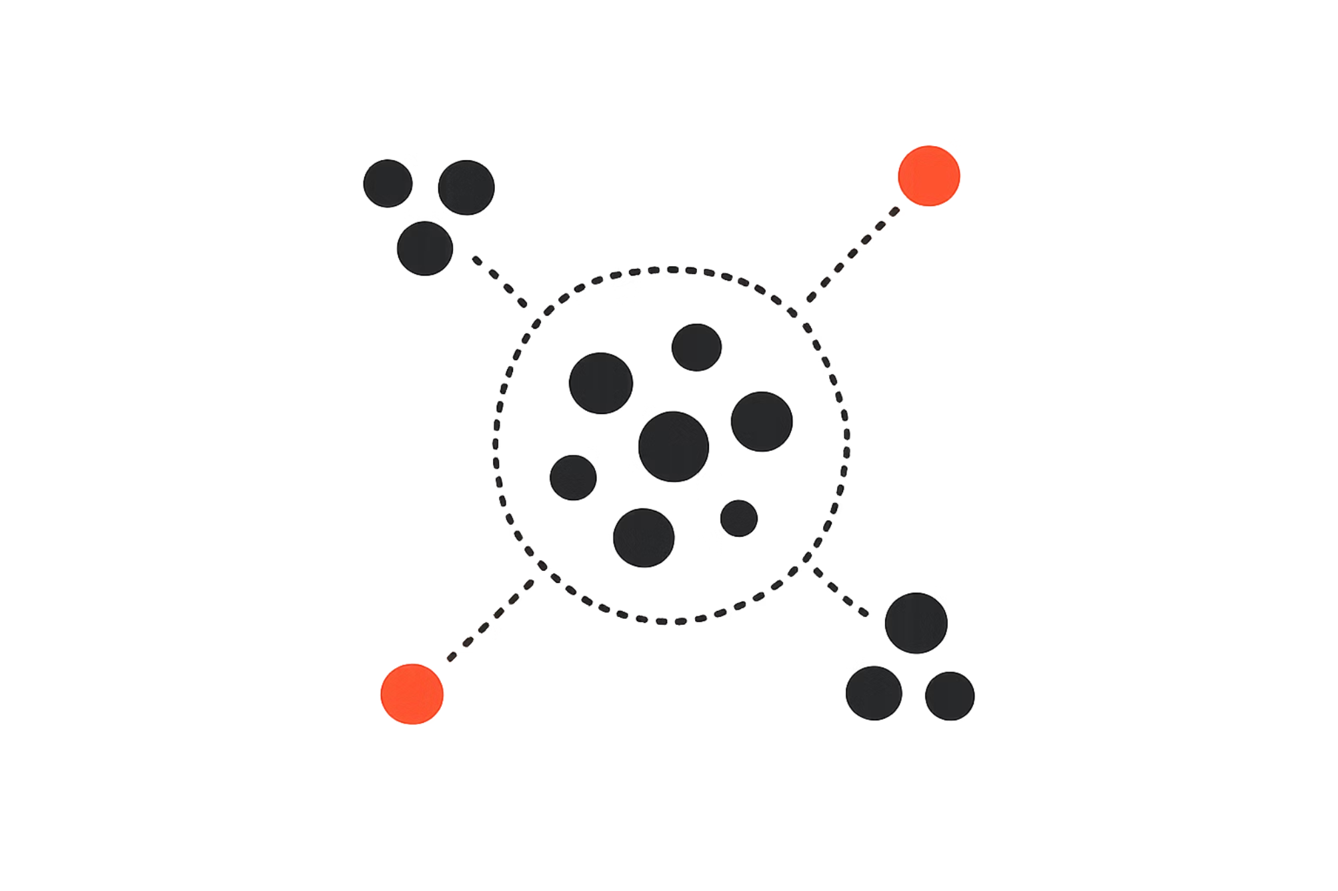

Unsupervised Methods & Key Takeaways
🔹 Unsupervised Methods
Require no labeled data. Outliers are identified through structural properties of the data itself.
Key Takeaway: The right method depends on your data — labels, dimensionality, and domain context all matter.
Distance-Based
Density-Based
Clustering-Based
Points far from neighbors are flagged (e.g., k-NN, LOF)
Low-density regions indicate anomalies (e.g., DBSCAN)
Points outside all clusters are treated as outliers

